Slide 1

Basic Web Project
MVC, Spring and Thymeleaf
SoftUni Team
Technical Trainers
Software University
https://softuni.bg

Slide 2
Table of Contents
Model-View Controller (MVC)
Spring MVC
Annotations
Controllers
Processing Requests
Thymeleaf View Engine

Slide 3
Have a Question?
sli.do
#fund-java

Slide 4
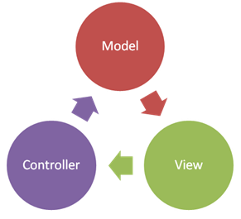
MVC
Model-View Controller

Slide 5
What is Model-View Controller
MVC == Model-View-Controller
Views (presentation / UI)
Render UI (produce HTML)
Controllers (logic)
Prepare UI (presentation logic)
Update database (business logic)
Models (data)
Data access classes or ORM

Slide 6
Model (Data)
Set of classes that describes the data we are working with
Rules for how the data can be changed and manipulated
May contain data validation rules
Often encapsulates data stored in a database

Slide 7

View
Defines how the application's user interface (UI) will be displayed
May support master views (layouts)
May support sub-views (partial views or controls)
May use templates to dynamically generate HTML

Slide 8
Controller
The core MVC component - holds the logic
Process the requests
A set of classes that handles
Communication from the user
Overall application flow
Application-specific logic (business logic)
Every controller has one or more "actions"

Slide 9
The MVC Pattern
HTTP Request
Front controller (dispatcher)
/Some/Page/
Delegate request
User
Controller
HTTP Response
Select view & pass data
CRUD operations
View
(render UI)
Model (data)
Use data from
the model

Slide 10
Spring MVC

Slide 11

Spring MVC
Spring MVC == open source Web MVC framework for Java
Developed by Pivotal Software
https://spring.io
Built top of Java Servlet API

Slide 12
Spring Boot
Simplifies building Spring applications
Convention-over-configuration
Rapid application development with Spring
Create production-grade applications that you can "just run"
Automatically configure Spring Framework
Built-in Web server (Tomcat)
Integrates Spring MVC, Spring Data and other Spring technologies

Slide 13
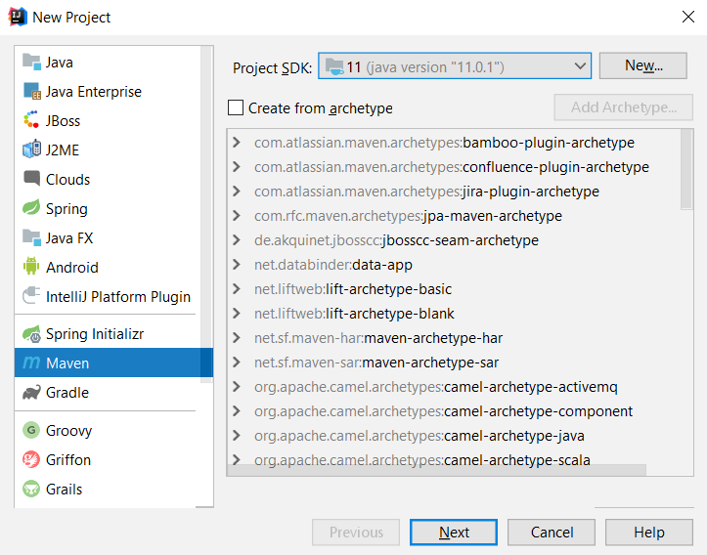
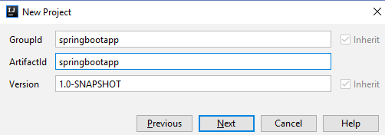
Starting with Spring Boot
Create a new Maven-based Java project

Slide 14
Starting with Spring Boot
pom.xml
<parent>
<groupId>org.springframework.boot</groupId>
<artifactId>spring-boot-starter-parent</artifactId>
<version>2.0.4.RELEASE</version>
</parent>
<dependencies>
…
</dependencies>
<properties><java.version>11</java.version></properties>

Slide 15
Starting with Spring Boot (2)
pom.xml
<dependency>
<groupId>org.springframework.boot</groupId>
<artifactId>spring-boot-starter-thymeleaf</artifactId>
</dependency>
<dependency>
<groupId>org.springframework.boot</groupId>
<artifactId>spring-boot-starter-web</artifactId>
</dependency>

Slide 16
Spring Boot Application Class
src/main/java/app/MvcAppExample.java
package app;
import org.springframework.boot.*;
import org.springframework.boot.autoconfigure.*;
@SpringBootApplication
public class MvcAppExample {
public static void main(String[] args) {
SpringApplication.run(MvcAppExample.class, args);
}
}

Slide 17
Spring Annotations
Spring uses strongly-typed annotations
Syntax highlighting + error checking
Describe the code below them
@Controller
public class HomeController {
…
}
@GetMapping("/hello")
public ModelAndView hello() {
…
}

Slide 18
Spring Controllers
MVC controllers hold actions, mapped to URL by annotations
Defined with @Controller annotations
Controllers can hold multiple actions on different routes
@Controller
public class HomeController {
…
}
Mapped to http://localhost:8080/hello
@GetMapping("home")
public ModelAndView home (ModelAndView modelAndView) { … }

Slide 19
Controller Actions
GetMapping – GET Request
PostMapping – POST Request
@GetMapping("/home")
public ModelAndView home(ModelAndView modelAndView) {
…
}
@PostMapping("/register")
public ModelAndView register(ModelAndView modelAndView) {
…
}

Slide 20
Spring Controller: Example
Create Web controller + action /hello + view hello.html
@Controller
public class GreetingController {
@GetMapping("/hello")
public ModelAndView home(ModelAndView modelAndView) {
modelAndView.setViewName("hello.html");
return modelAndView;
}
}
HTML File in resources/templates/hello.html

Slide 21

Thymeleaf
Template Engine

Slide 22
Thymeleaf
Thymeleaf is a view engine used in Spring MVC
Natural templates – HTML with additional attributes to add view logic
Thymeleaf allows us to:
Use variables / collections in our views
Execute operations on our variables
Iterate over collections

Slide 23
Thymeleaf Tags and Attributes
All Thymeleaf tags and attributes begin with th:
Example of Thymeleaf attribute
th:block is an attribute container that disappears in the HTML
<p th:text="Example">…</p>
<th:block>
…
</th:block>

Slide 24
Thymeleaf Variable Expressions
Variable Expressions are executed on the context variables
Examples:
${ … }
${title}
${article.title}
${article.author.name}

Slide 25
Thymeleaf Link Expressions
Link Expressions are used to build URLs
Example:
You can also pass query string parameters
Create dynamic URLs
@{ … }
<a th:href="@{/register}">Register</a>
<a th:href="@{/details(id=${game.id})}">Details</a>
<a th:href="@{/games/{id}/edit(id=${game.id})}">Edit</a>

Slide 26
Forms in Thymeleaf
In Thymeleaf you can create HTML forms:
You can parse the input as an object
<form th:action="@{/user}" th:method="post">
<input type="number" name="id"/>
<input type="text" name="name"/>
<input type="submit">
</form>
@PostMapping("/user")
public ModelAndView register(@ModelAttribute User user) { … }

Slide 27
Conditional Statements in Thymeleaf
You can use if statements in thymeleaf using th:if
You can create inverted if statements using th:unless
<div th:if="${…}">
<p>The statement is true"</p>
</div>
<div th:unless="${…}">
<p>The statement is false"</p>
</div>

Slide 28
Loops in Thymeleaf
For loop
Example:
<div th:each="element :
${#numbers.sequence(start, end, step)}">
<p th:text="${element}"></p>
</div>
<div th:each="element : ${#numbers.sequence(1, 5, 1)}">
<p th:text="${element}"></p>
</div>
//1 2 3 4 5

Slide 29
Loops in Thymeleaf (2)
For-each loop
Example
<div th:each="item : ${collection}">
<p th:text="${item.property}"></p>
</div>
<div th:each="book : ${books}">
<p th:text="${book.name}"></p>
<p th:text="${book.author}"></p>
<p th:text="${book.price}"></p>
</div>

Slide 30
Passing Attributes to View
Passing a string to the view
<body>
<p>Hello, <span th:text="${name}"></span></p>
</body>
@GetMapping("/hello")
public ModelAndView hello(ModelAndView modelAndView) {
modelAndView.setViewName("hello");
modelAndView.addObject("name", "Peter");
return modelAndView;
}

Slide 31
Passing Attributes to View (2)
Passing a collection to the view
<div th:each="book : ${books}">
<p th:text="${book.name}"></p>
</div>
@GetMapping("/all")
public ModelAndView listBooks(ModelAndView modelAndView) {
…
modelAndView.addObject("books", books);
return modelAndView;
}

Slide 32

Summary
…
…
…
Implementing MVC Pattern
Spring MVC
Open Source Framework for Java
Spring Boot
Configures and simplifies Spring apps
Thymeleaf
Powerful view engine
Expressions, Conditions and Iterations

Slide 33
Questions?
Notes:
33

Slide 34












SoftUni Diamond Partners

Slide 35


Educational Partners

Slide 36
Trainings @ Software University (SoftUni)
Software University – High-Quality Education, Profession and Job for Software Developers
softuni.bg, about.softuni.bg
Software University Foundation
softuni.foundation
Software University @ Facebook
facebook.com/SoftwareUniversity
Software University Forums
forum.softuni.bg
Notes:
36

Slide 37

License
This course (slides, examples, demos, exercises, homework, documents, videos and other assets) is copyrighted content
Unauthorized copy, reproduction or use is illegal
© SoftUni – https://about.softuni.bg/
© Software University – https://softuni.bg
Notes:
37

